Slide 1
HTML 마크업 시맨틱

Slide 2
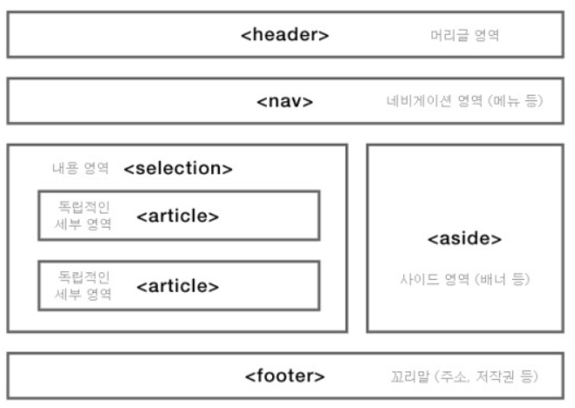
[ 문서 구조를 위한 HTML5 시맨틱 태그 ]

Slide 3
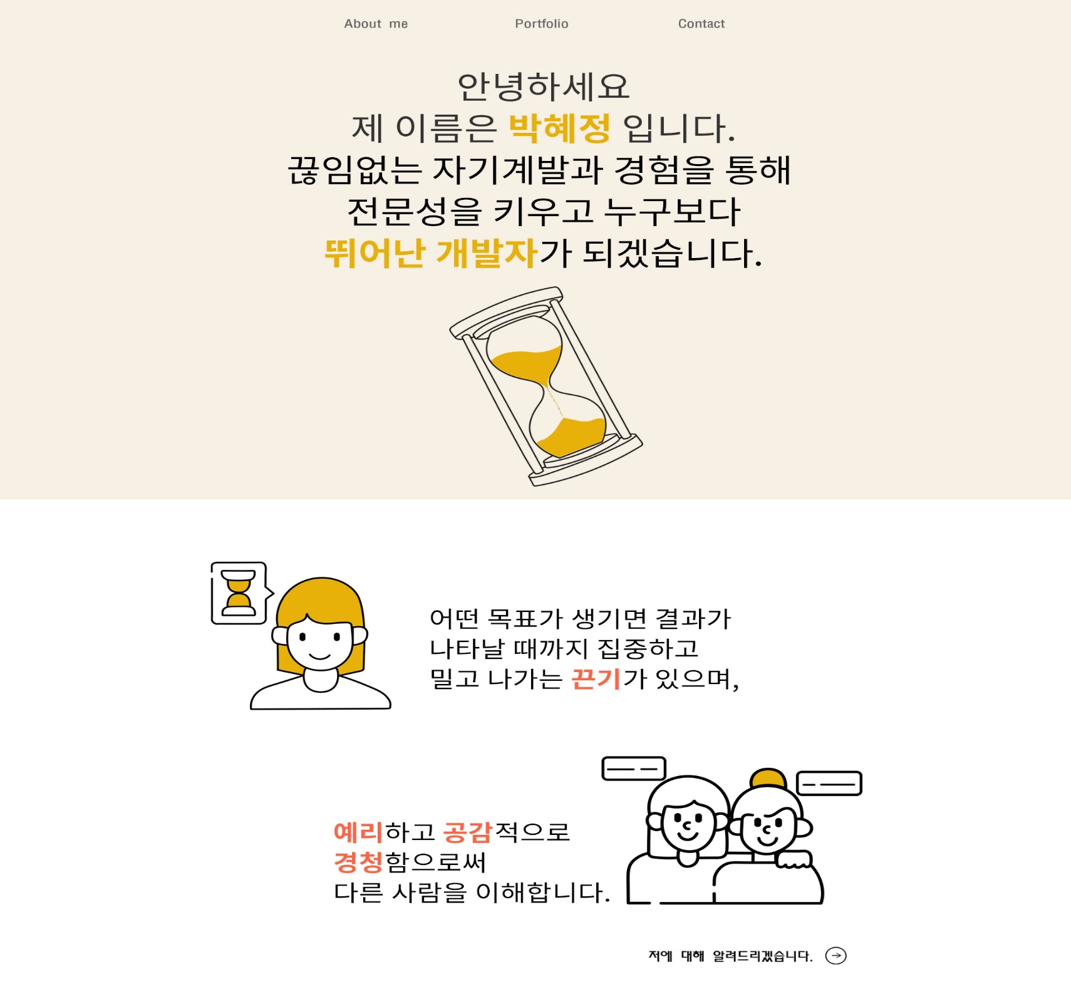
<nav id=“menu"></nav>
<div id="container 1"></div>
<p id=“dream"></p>
Or <header id="dream"></header>
-------------------------------------
Header로 적어도 되는지
<section id=“content"></section>
<img id=“dream">
v
<section id=“Advantages "></section>
<article id=“article1"></ article >
<div id="container 2"></div>
<article id=“article2"></ article >

Slide 4
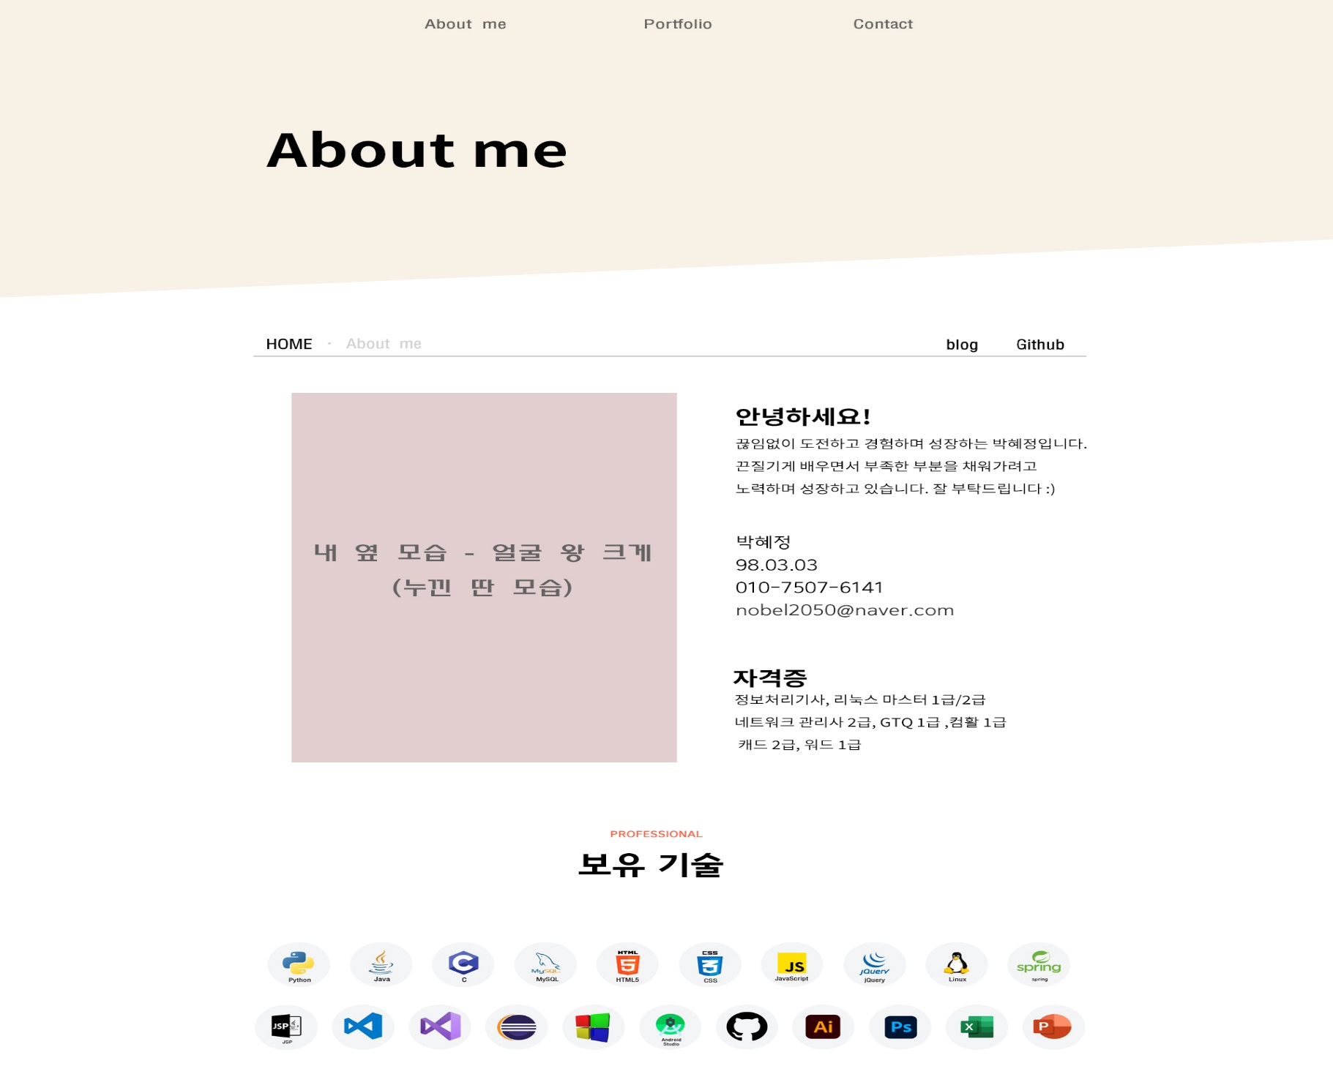
<nav id=“menu"></nav>
<div id="container 1"></div>
<header id=“contact"></header>
<div id=“content1"></div>
<main id=“content1"></main>
<aside id=“menuAboutme"></aside>
<div id=“content2"></div>
<main id=“content2"></main>
<section id=“introduce"></section>
안에는 article 3개
<section id=“skill"></section>

Slide 5

<div id="container3"></div>
<div id=“content3"></div>
<main id=“content3"></main>
<div id=“content4"></div>
<main id=“content4"></main>
<section id=“blogs"></section>
안에는 article 2개

Slide 6

<div id="container5"></div>
<div id=“content5"></div>
<main id=“content5"></main>
<footer></footer>

Slide 7
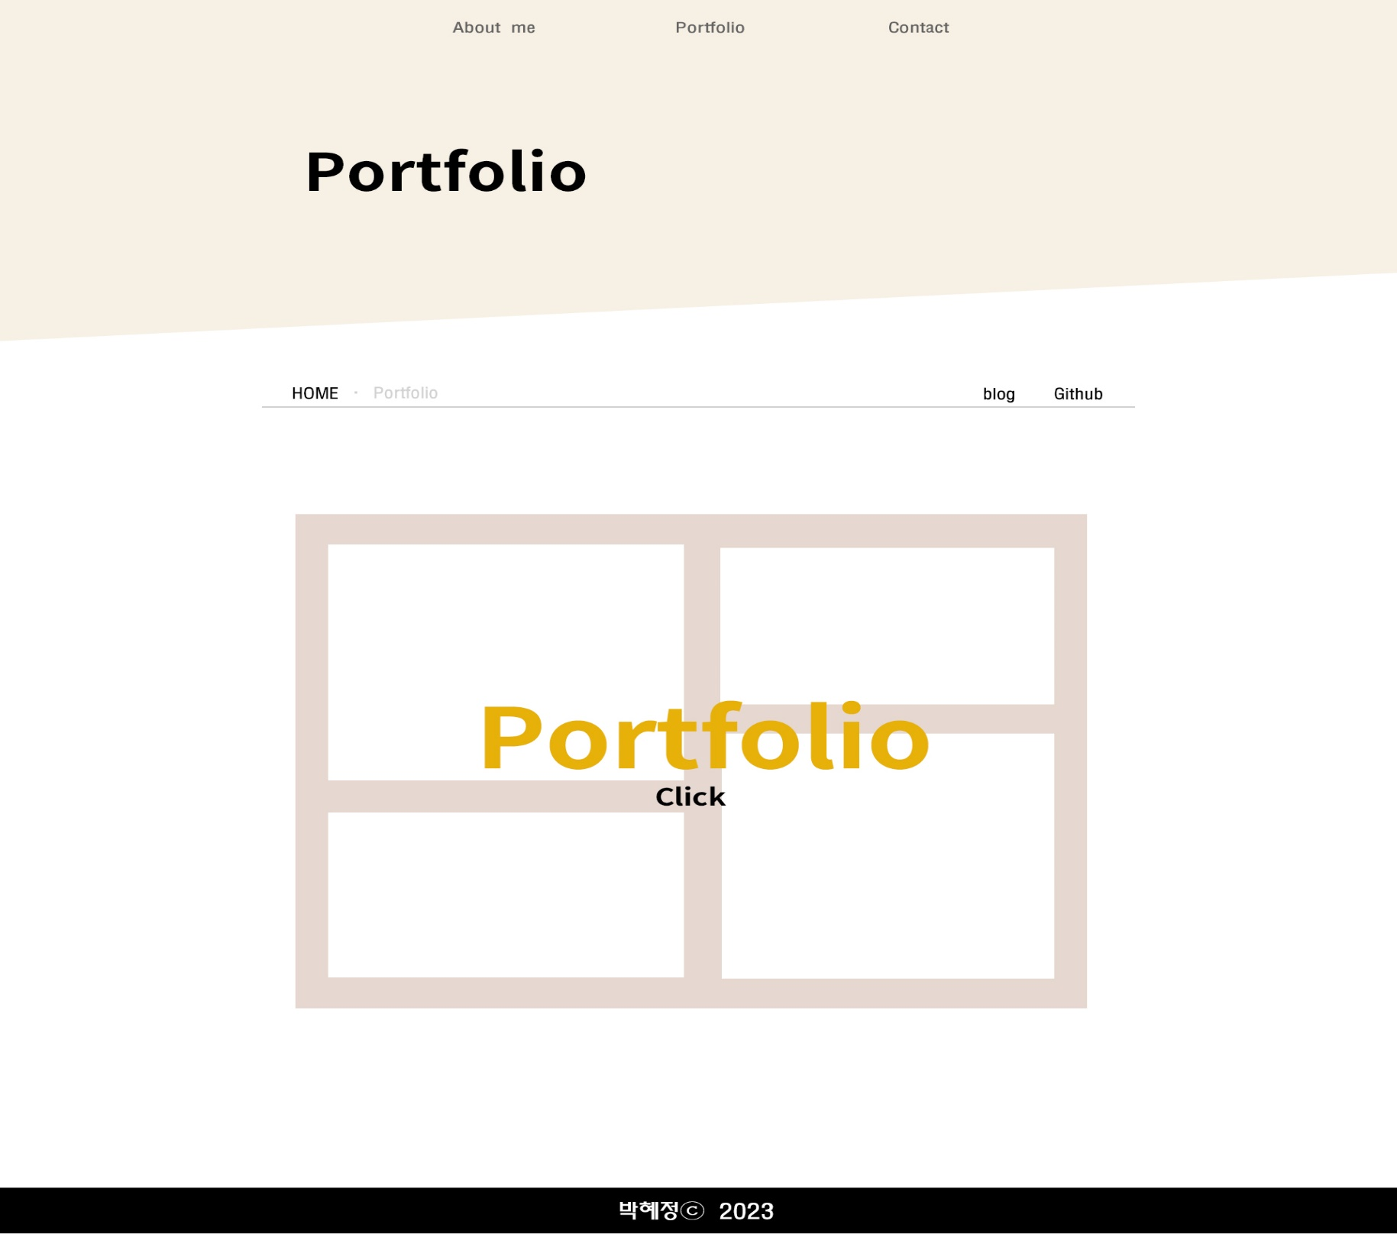
<nav id=“menu"></nav>
<div id="container 1"></div>
<header id=“contact"></header>
<div id=“content1"></div>
<main id=“content1"></main>
<aside id=“menuPortfolio"></aside>
<div id="container 2"></div>
<div id=“content2"></div>
<main id=“content2"></main>
<section id=“menuContact"></section>
<footer></footer>

Slide 8
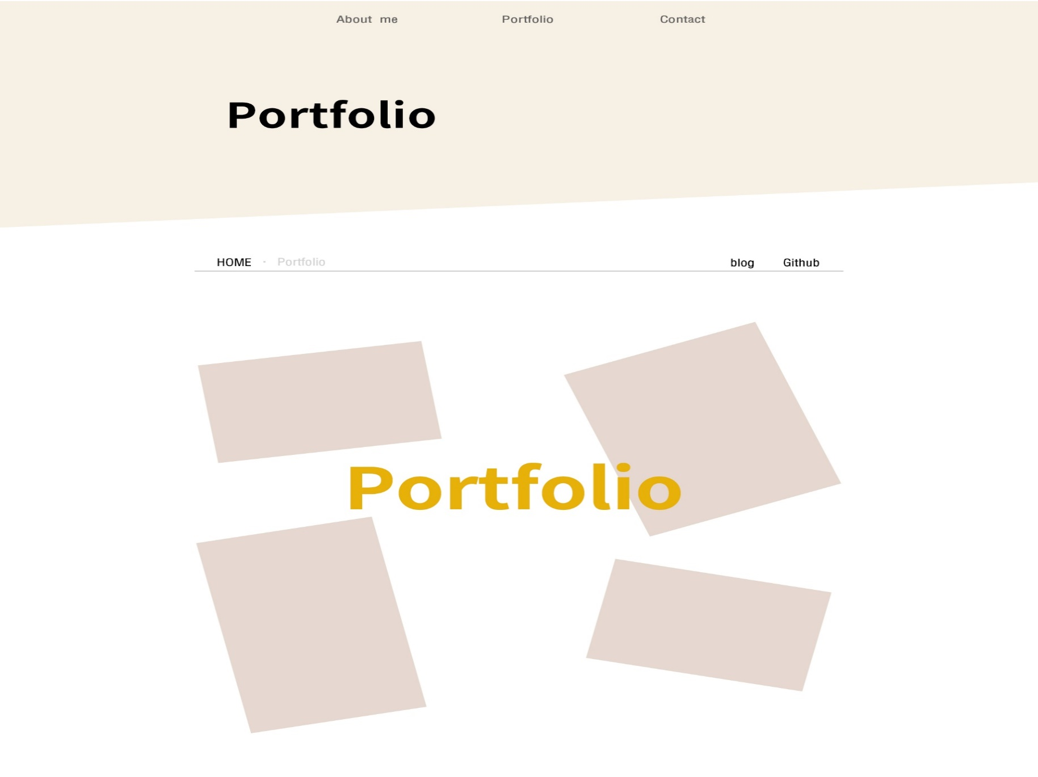
<nav id=“menu"></nav>
<div id="container 1"></div>
<header id=“contact"></header>
<div id=“content1"></div>
<main id=“content1"></main>
<aside id=“menuPortfolio"></aside>
<div id="container 2"></div>
<div id=“content2"></div>
<main id=“content2"></main>

Slide 9

<div id="container 1"></div>
<div id=“content1"></div>
<main id=“content1"></main>
<div id="container 2"></div>
<div id=“content2"></div>
<main id=“content2"></main>
<footer></footer>

Slide 10
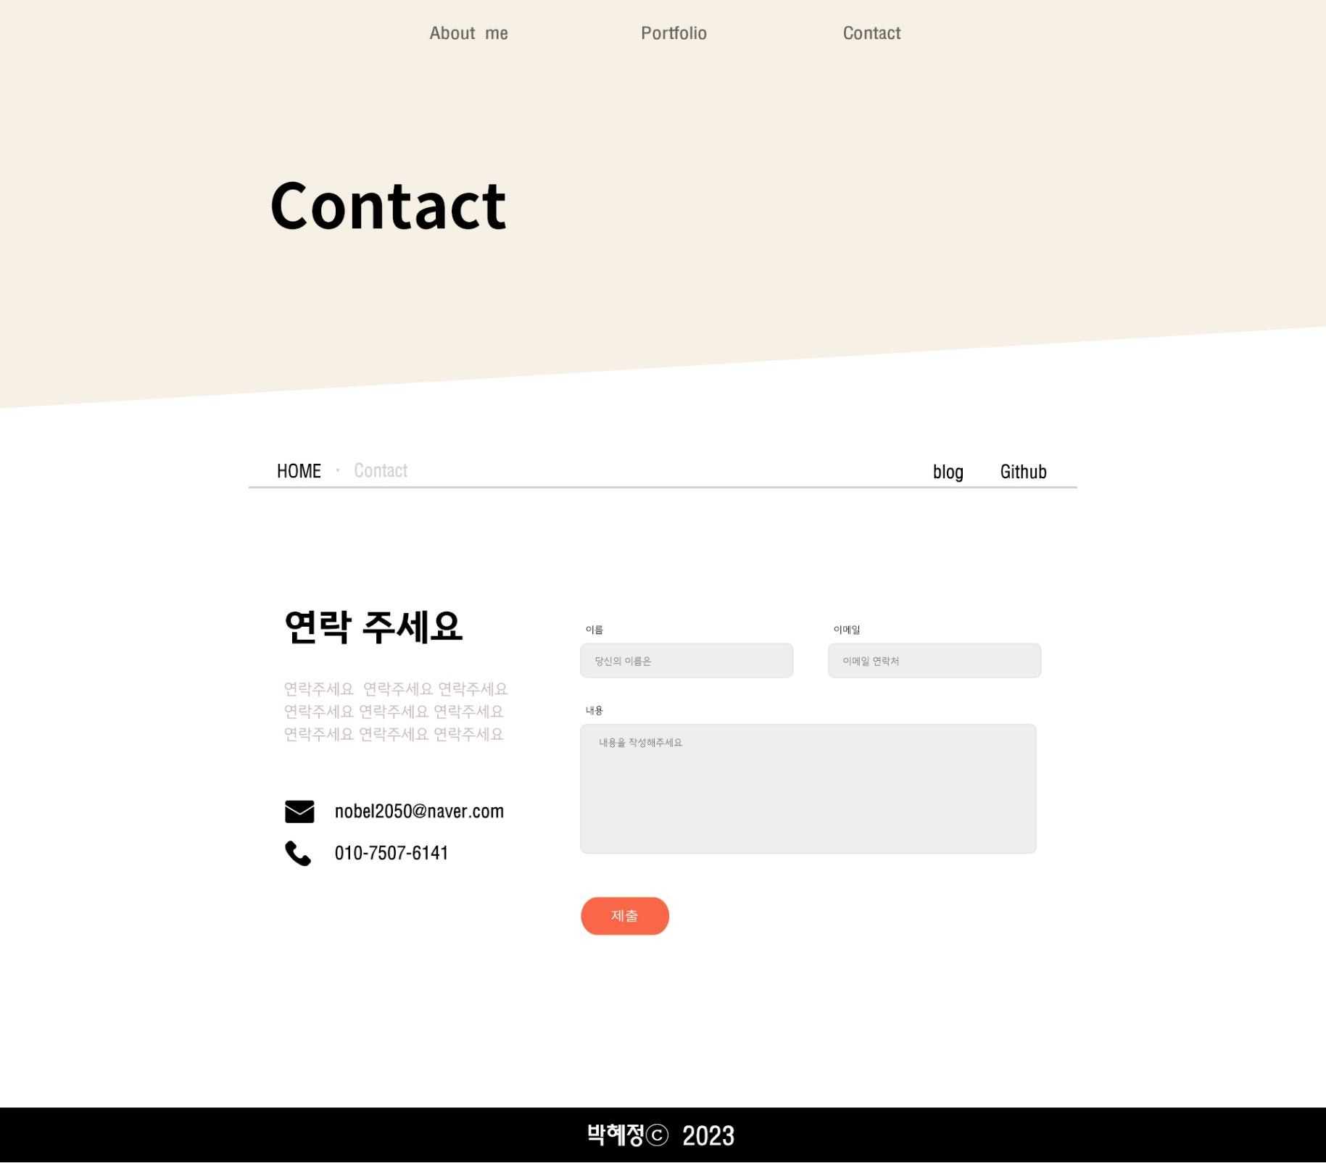
<nav id=“menu"></nav>
<div id="container 1"></div>
<header id=“contact"></header>
<div id=“content1"></div>
<main id=“content1"></main>
<aside id=“menuContact"></aside>
<input type="text">
<div id="container 2"></div>
<article id=“article1"></ article >
<div id=“content2"></div>
<main id=“content2"></main>
<a href="#"><img src" alt="" id=“submit_btn"></a>
<article id=“article2"></ article >
<footer></footer>

